Slide 1
A view into Software Cracking Part 2 Kalli Schlauch – GCIH, CEH, TCSM
Activation codes and KeyGens

Slide 2
Disclaimer
The content and views in this presentation are in no relation to my employer
I know nothing! – the content is not based on any training, rather my own observations and experiments from a long time back (yet still relevant)

Slide 3
Todays Agenda
Show cool stuff, but this comes at a price
Gather Activation code (demo)
Understand Algorithm and create Keygen (demo)

Slide 4
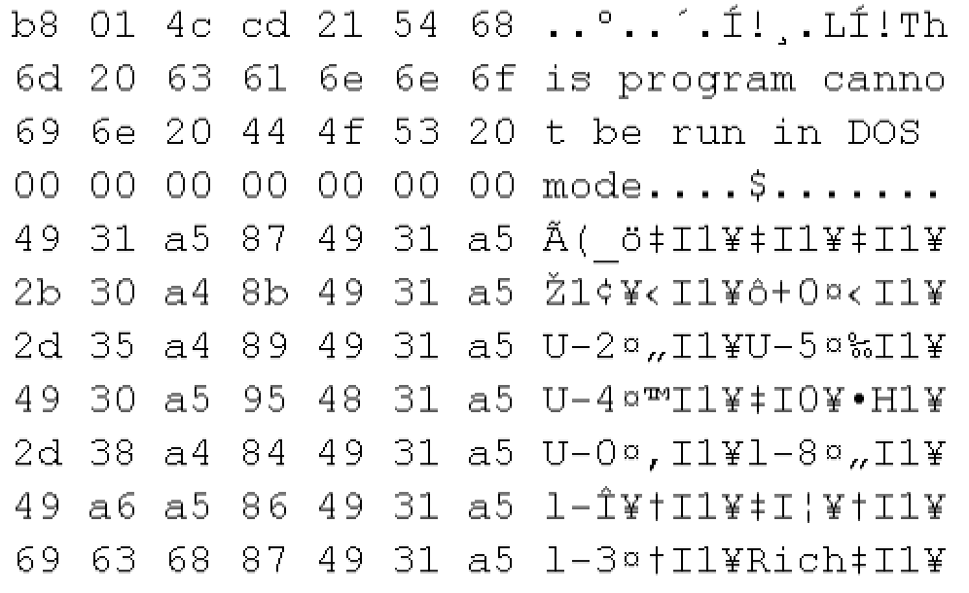
Windows Applications
Visual Studio, C++, Assembly, Machine Code
Portable Executable (PE)
#include <stdio.h>
int main()
{
int a=2;
int b=3;
int c=a+b;
printf("result is %d", c);
return 0;
}
Libraries
C-Compiler and linker
MOV EAX, 2
MOV EBX, 3
ADD EAX, EBX
...
.section __TEXT,__cstring,cstring_literals
L_.str: ## @.str
.asciz "result is %d"
Assembler
Disassembler
Notes:
C++ most

Slide 5
Concepts
MFC Library and System DLLs
“Microsoft Foundation Class Library (MFC) is a C++ object-oriented library for developing desktop applications for Windows” – since 1992
KERNEL32.DLL
most of the Win32 base APIs, such as memory management, input/output (I/O) operations, process and thread creation, and synchronization functions
USER32.DLL
implements the Windows USER component that creates and manipulates the standard elements of the Windows user interface, such as the desktop, windows, and menus
WS2_32.DLL
implements the Winsock API, which provides TCP/IP networking functions
… many many more
Quotes of wikipedia
Notes:
C++ most

Slide 6
Concepts
ASCII Table
(original lower half)
CSec+
C – 0x43 – 67
S – 0x53 – 83
e – 0x65 – 101
c – 0x63 – 99
+ – 0x2B – 43
https://github.com/tomgibara/ascii-table/wiki
Notes:
C++ most

Slide 7
Concepts
ASCII vs WIDE
C – 0x43 – 67
S – 0x53 – 83
e – 0x65 – 101
c – 0x63 – 99
+ – 0x2B – 43
ASCII string in memory
C | S | e | c | + | .
43 | 53 | 65 | 63 | 2b | 00
WIDE (Unicode) string in memory
C | . | S | . | e | . | c | . | + | . | . | .
43 | 00 | 53 | 00 | 65 | 00 | 63 | 00 | 2b | 00 | 00 | 00
https://unicode-table.com/en/
Notes:
C++ most

Slide 8
Concepts
Debugger
A debugger or debugging tool is a computer program that is used to test and debug other programs (the "target" program (Wikipedia)
Software that allows you to go step-by-step through a live program and while doing it displays actual code and memory content (Kalli)
common ones include
Visual Studio (the IDE offers its own debugger)
SoftIce (back then tool of the trade) – sold (around the time of Quake II) … and killed off
OllyDbg – currently most commonly used (free)
WinDbg – Windows Debugger (free). Often used for crashdump analysis (support environments). We’ll use this one (probably the most useful in your working career)

Slide 9
DON’T WORRY
NO NEED TO REMEMBER
THIS FOR NOW!
I JUST NEEDED TO MENTION IT
Concepts
CPU registers
All registers are like variables. Each with a fixed or typical purpose
EAX, EBX, ECX, EDC are commonly used for calculations. EAX often used for function results (return values from calls). ESI, EDI can also be used b ut they have additional reserved use (string operations like REPNZ SCASB etc)
EIP (Instruction pointer) points to exactly what code in memory is being executed next. Think line numbers in old basic programs
EBP/ESP are stack pointers (they point to where values are stored in memory)
Sub registers
Example:
EAX = 12345678 (hex) (EAX, EBX, ECX and EDX all 4 bytes each. Yes.. 32bit computing)
AX = 5678
AH = 56
AL = 78
(same is valid for the other 3: ECX -> CX, CH, CL)
Notes:
ABCD (Accumulator, Base, Count, Data)

Slide 10
Playing Hopscotch
Flipping Jumps!

Slide 11
Live Demo 1
Find our own personal activation code
CSec+

Slide 12
Live Demo 2
Clean Slate – we start from scratch!
Understand the algorithm and create a keygen

Slide 13
What next?
Where do I find further reading material?
To learn more about this subject there is an array of tutorials. Some of them even discussing specific software. Careful browsing …
OLD/still valid! HCU material +Fravia/+ORC (crawled) http://acrigs.com/FRAVIA/entran.htm
OLD/still valid! www.woodmann.com web archives of tuts, etc
https://beginners.re/ reverse engineering for beginners, free eBook
Debugging and key-generators: can I come back?

